Slide 1

Genetics
Chapter 6

Slide 2
6.3 Mendel and Heredity
After this section you will be able to……
Describe Mendel’s contributions to genetics
Explain what traits are and how they are passed on

Slide 3

TEKS
B.6F - predict possible outcomes of various genetic combinations such as monohybrid crosses, dihybrid crosses and non-Mendelian inheritance

Slide 4
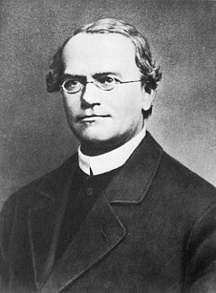
Gregor Mendel
Austrian Monk
Raised by peasants who worked as gardeners
Studied genetics in the 1800’s
Conducted his experiments using pea plants
Known as ‘Father of Genetics’

Slide 5
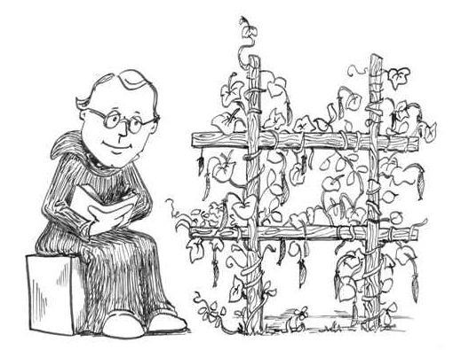
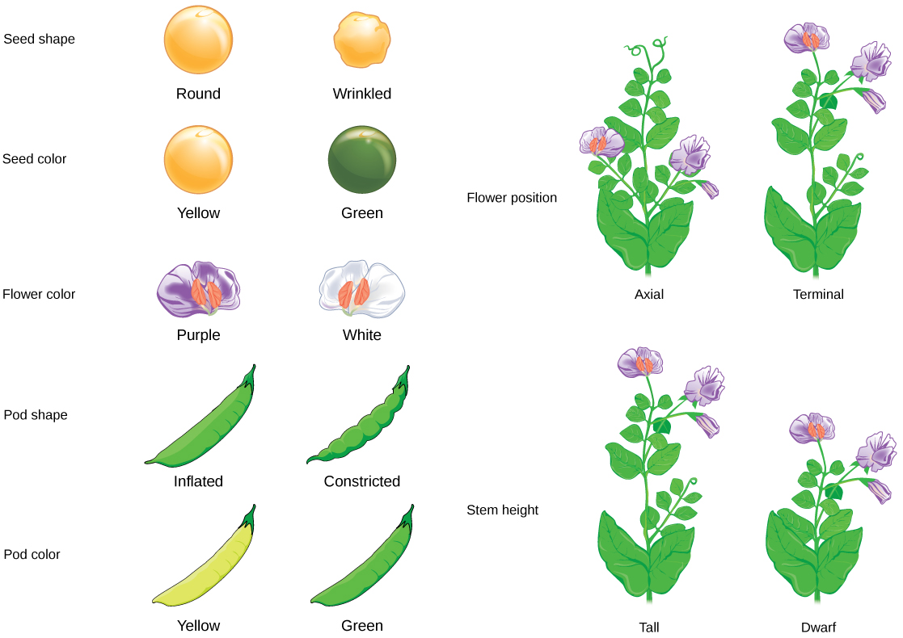
Why pea plants???
Why these traits???

Slide 6
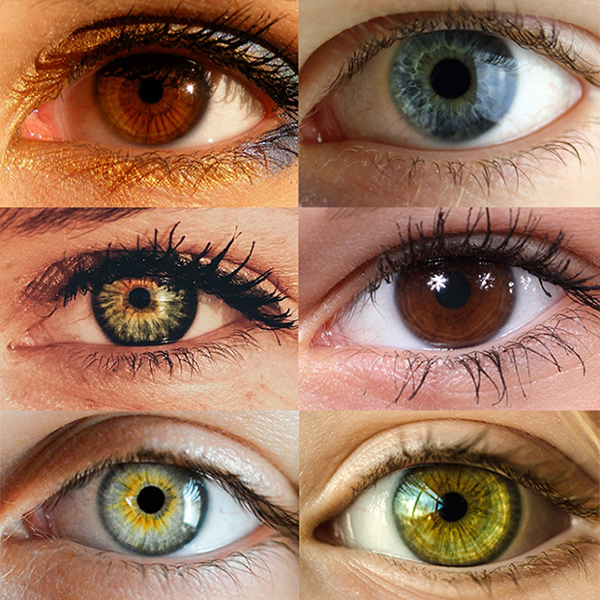
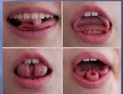
Traits and Genetics
Traits are characteristics that are inherited, such as eye color, leaf shape, or tail length
Genetics is the study of biological inheritance patterns and variation in organisms

Slide 7
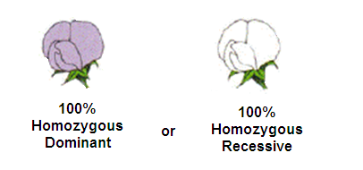
Mendel’s Experiments
P Generation (Parental Generation)
Mendel allowed two plants to self-pollinate until all offspring displayed only one characteristic (example, all purple) - True breeding
A true breeding plant will only allow one since it’s homozygous dominant or homozygous recessive

Slide 8
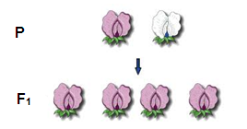
Mendel’s Experiments
He then picked two parents, each with contrasting traits (one purple and one white) and cross-pollinated them.
F1 generation
The offspring of the Parental Generation which Mendel crossbred; this generation only expressed one trait (dominant, purple)

Slide 9
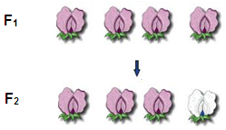
Mendel’s Experiments
Next, he allowed the F1 Generation plants to self-pollinate.
F2 generation
The self-pollinating offspring of the F1 Generation. This generation expressed both traits again, although the dominant (purple) trait was expressed more often (3:1)

Slide 10
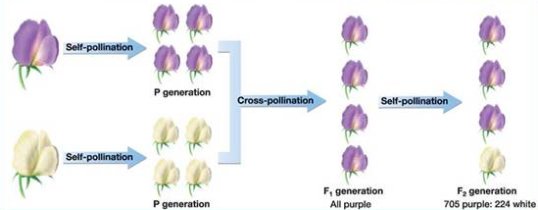

Slide 11
6.4 Traits, Genes, and Alleles
After this section you will be able to……
Describe the relationship between traits and alleles
Explain the different results of genetic offspring
Compare dominant/recessive alleles, heterozygous/homozygous, and genotype/phenotype

Slide 12
TEKS
B.6F - predict possible outcomes of various genetic combinations such as monohybrid crosses, dihybrid crosses and non-Mendelian inheritance

Slide 13
Recall….

Slide 14
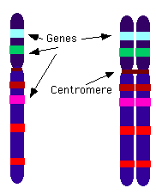
Mendel’s Hypotheses
An individual has two copies of a gene - one from each parent
There are different versions of each gene
For example, the gene for flower color in pea plants can either be purple or white, represented by letters;
P = purple and p = white

Slide 15
Mendel’s Hypotheses
Alleles are the different versions of the genes; represented by the letters
One allele is dominant, one is recessive
Dominant: expressed form of trait (capital allele)
Recessive: not expressed form of a trait (lower-case allele)

Slide 16
Mendel’s Conclusions
Homozygous means the organism having two identical alleles for a trait; either two dominant or two recessive
Heterozygous is having two different alleles
Homozygous Dominant: BB or TT or QQ
Homozygous Recessive: bb or tt or qq
Heterozygous: Bb or Tt or Qq

Slide 17
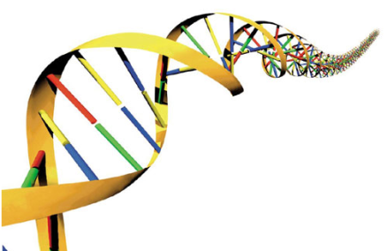
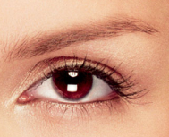
Mendel’s Conclusions
Genotype is the set of alleles that an individual trait has (the actual genes) Ex: BB, Tt, or qq
Phenotype is the physical appearance of a trait (how it actually appears) Ex: brown eyes, blue eyes, tall, short, stubby tail, long tail

